Slide 1

VeritasGraph: Sovereign GraphRAG for the Enterprise
Welcome to the future of Retrieval-Augmented Generation. We are moving beyond simple chatbots to build production-grade, verifiable, and sovereign AI systems. Introducing a framework designed to solve the "black box" problem in modern AI.

Slide 2

The Enterprise AI "Gold Rush" & The Trust Barrier
Organizations everywhere are rushing to deploy RAG solutions. However, serious enterprise deployment often hits a critical wall: Trust. Without transparency, even the most powerful model is a liability.
Lack of Reasoning
Standard models struggle to connect disparate facts across documents.
Missing Attribution
Users cannot audit where the answer came from or verify its accuracy.
Data Sovereignty
Reliance on external APIs exposes sensitive corporate IP to third parties.

Slide 3
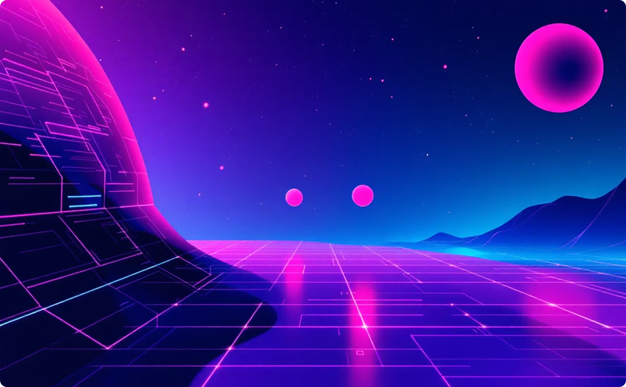
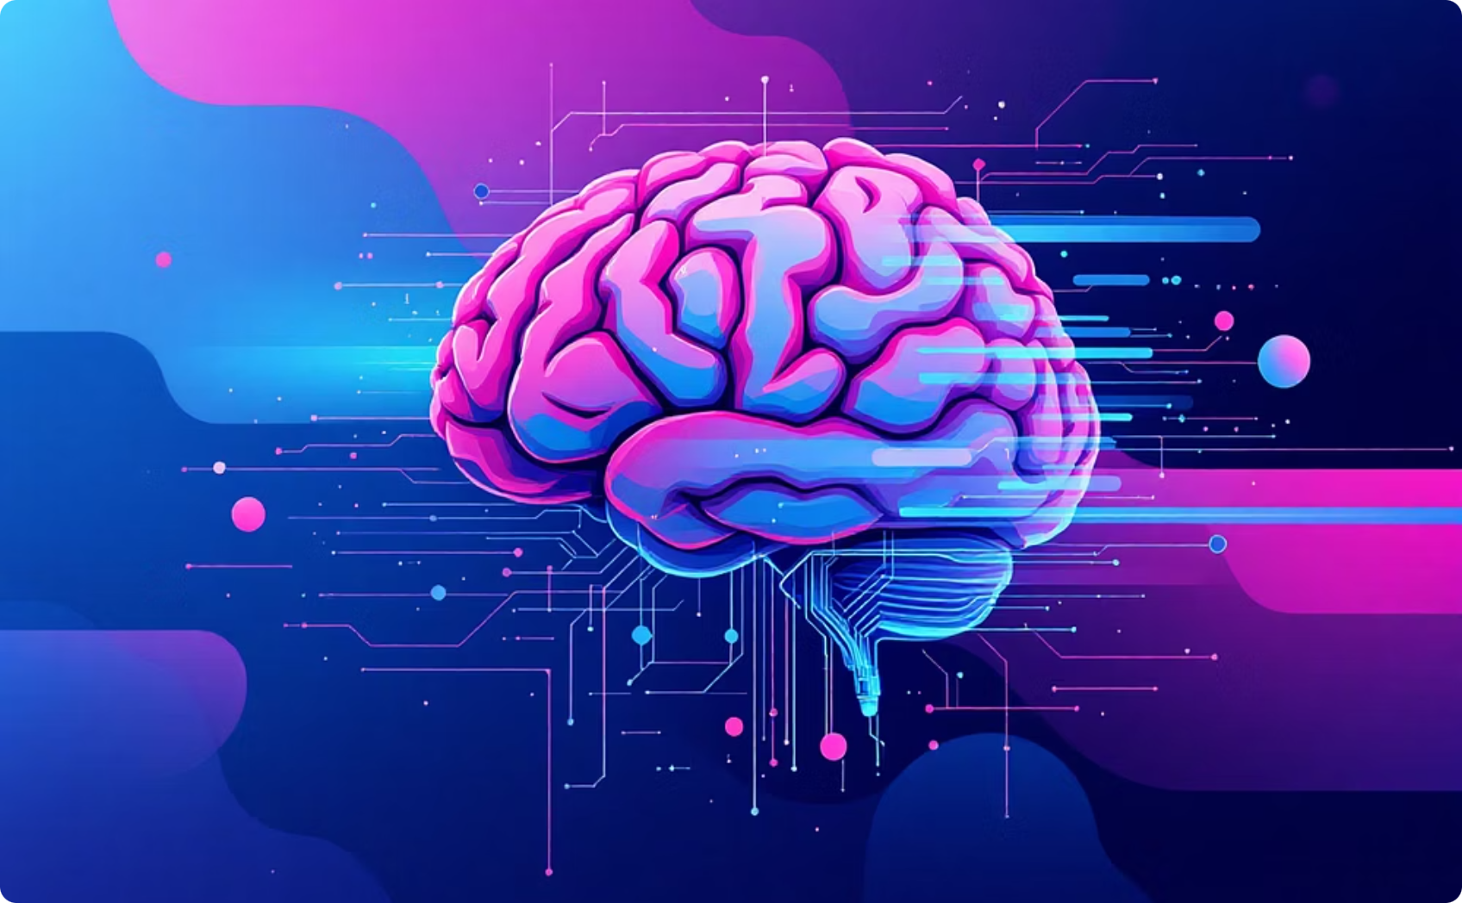
The Limitation of "Baseline" Vector Search
Standard RAG is excellent at finding a needle in a haystack, provided the answer exists explicitly in one paragraph. It fails when the answer requires Multi-Hop Reasoning across different documents.
The Vector Blindspot
The Hallucination Risk
If a user asks how "Project A" relates to a "Patent in Project B," a vector database sees two unrelated documents. It cannot intuitively "connect the dots" between separated entities.
When context is missing, LLMs fill the gaps with hallucinations. In an enterprise setting, a plausible but false answer is more dangerous than no answer at all.

Slide 4
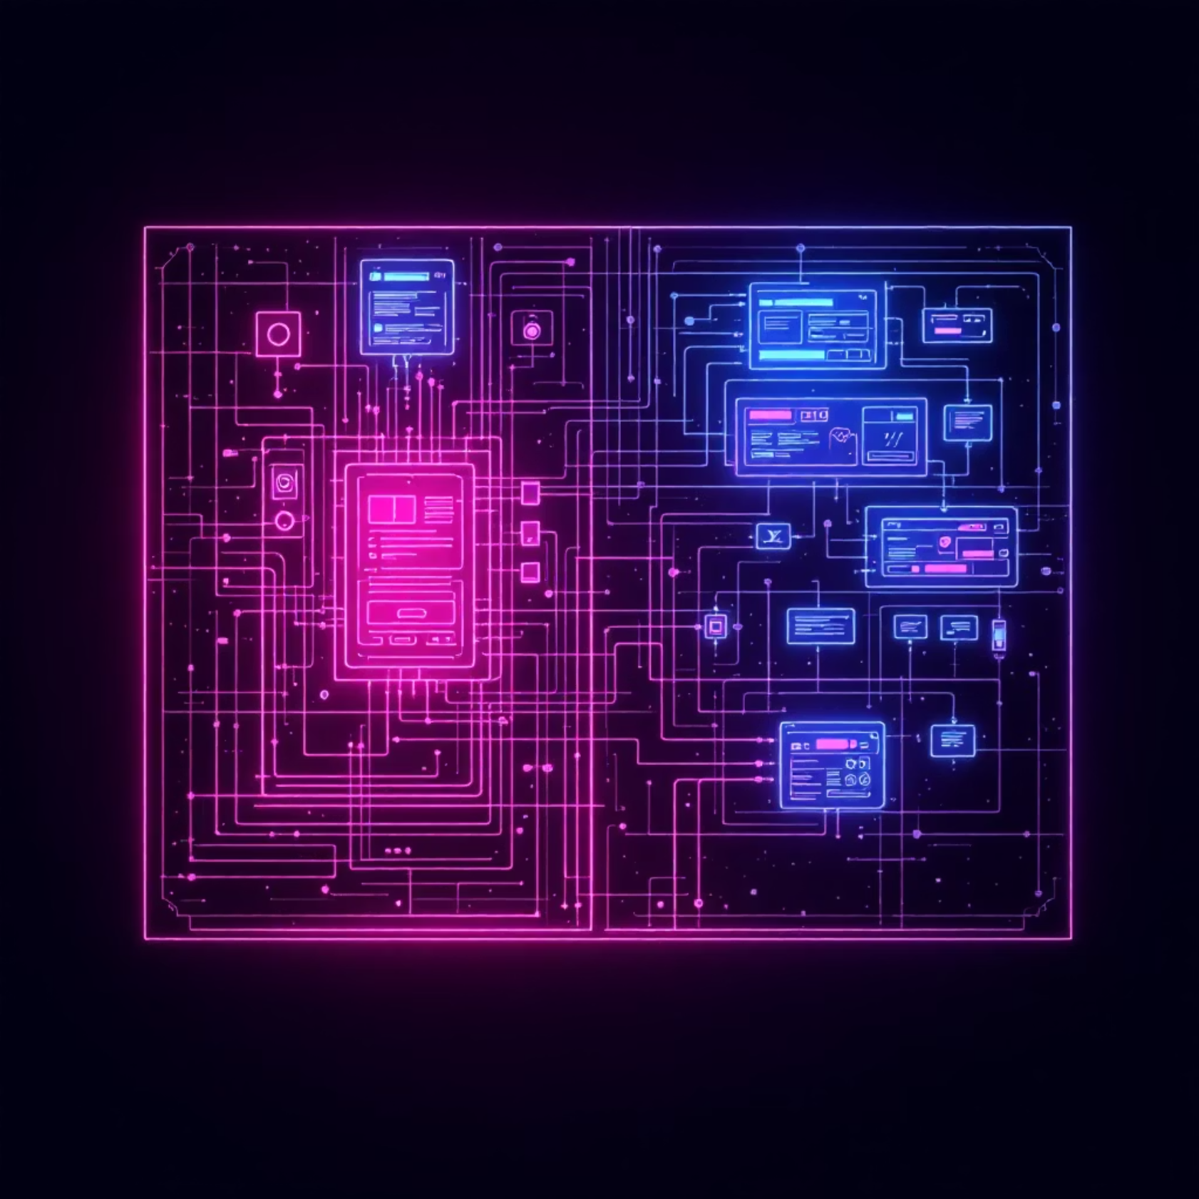



A New Architecture: The Sovereign Knowledge Asset
VeritasGraph isn't just about retrieving text; it's about building a Sovereign Knowledge Asset that lives entirely within your infrastructure. We provide transparent, auditable reasoning paths for every claim.
Private Infrastructure
Operates 100% on-premise or in your private cloud.
Graph-Based
Leverages Neo4j to map relationships, not just similarity.
Auditable
Every output traces back to a specific source document.

Slide 5



Stage 1: Knowledge Graph Construction
We move beyond simple text chunking. Our pipeline transforms unstructured data into a structured intelligence layer using advanced entity extraction.
Structuring
Extraction
These insights are committed to a Neo4j database, creating a rich graph of interconnected knowledge.
Ingestion
An LLM analyzes the text to identify key entities (people, projects, dates) and the semantic relationships between them.
Raw PDFs, text files, and documentation are ingested into the system.

Slide 6
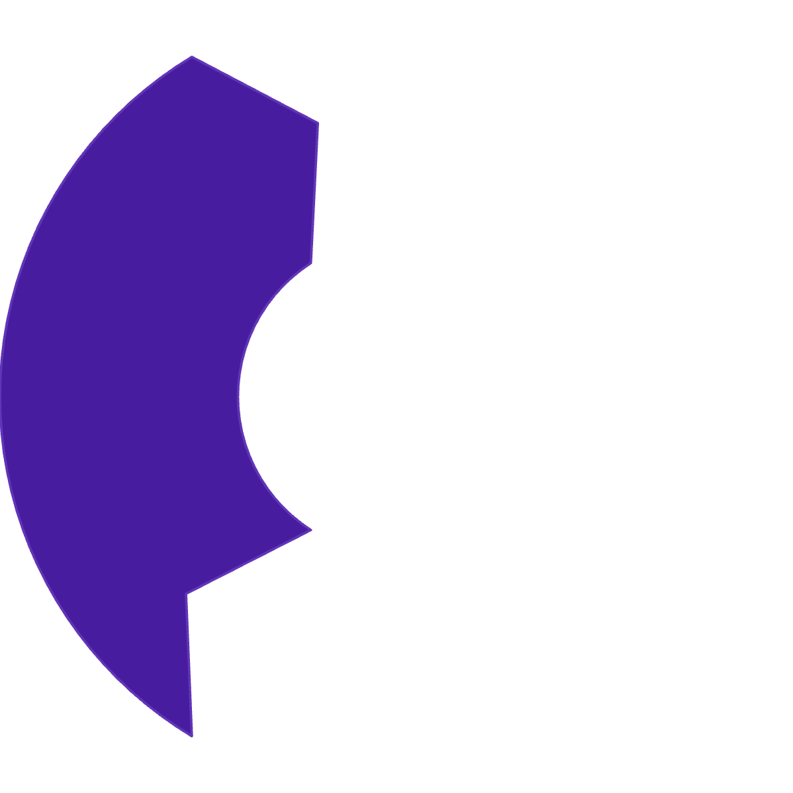





Stage 2: The Hybrid Retrieval Engine
To answer complex, holistic questions, VeritasGraph employs a dual-approach strategy that captures both semantic similarity and structural relationships.
Graph Traversal
The system "walks" the edges of the graph from these entry points, discovering hidden connections vector search would miss.
Vector Entry
We use Vector Search to identify the most relevant "entry nodes" in the graph based on the user's query.
Context Assembly
Relevant nodes and edges are aggregated to form a comprehensive context window for the LLM.

Slide 7

Stage 3: Reasoning with LoRA-Tuned Models
Generic models are often too broad. VeritasGraph is optimized for use with LoRA-Tuned LLMs (Low-Rank Adaptation), specifically fine-tuned for logical reasoning and strict adherence to context.
Local Efficiency: optimized to run on consumer hardware or standard enterprise servers.
Specialized Tuning: Models like Llama 3 are tuned specifically for citation and graph interpretation.
Reduced Latency: Faster inference times compared to massive general-purpose models.

Slide 8
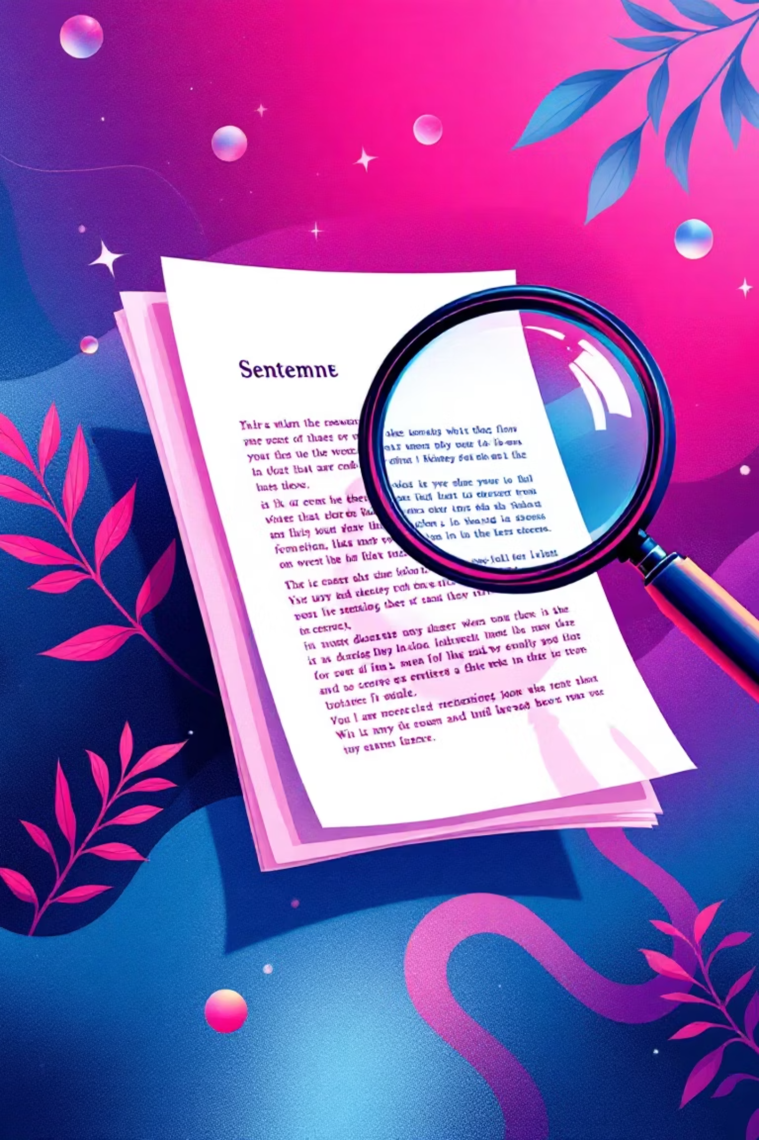
Stage 4: Verifiable Attribution
This is the cornerstone of the framework. We eliminate the "trust me, bro" aspect of AI. We provide a structured JSON output containing the provenance of every fact.
Traceable Claims
JSON Provenance
If the model states "X causes Y," it points exactly to the document and paragraph where it learned that fact.
Developers receive structured data citing source nodes, ensuring easy integration into frontend UI audit trails.
Defensible AI
In regulated industries, the ability to prove why an AI made a decision is mandatory, not optional.

Slide 9
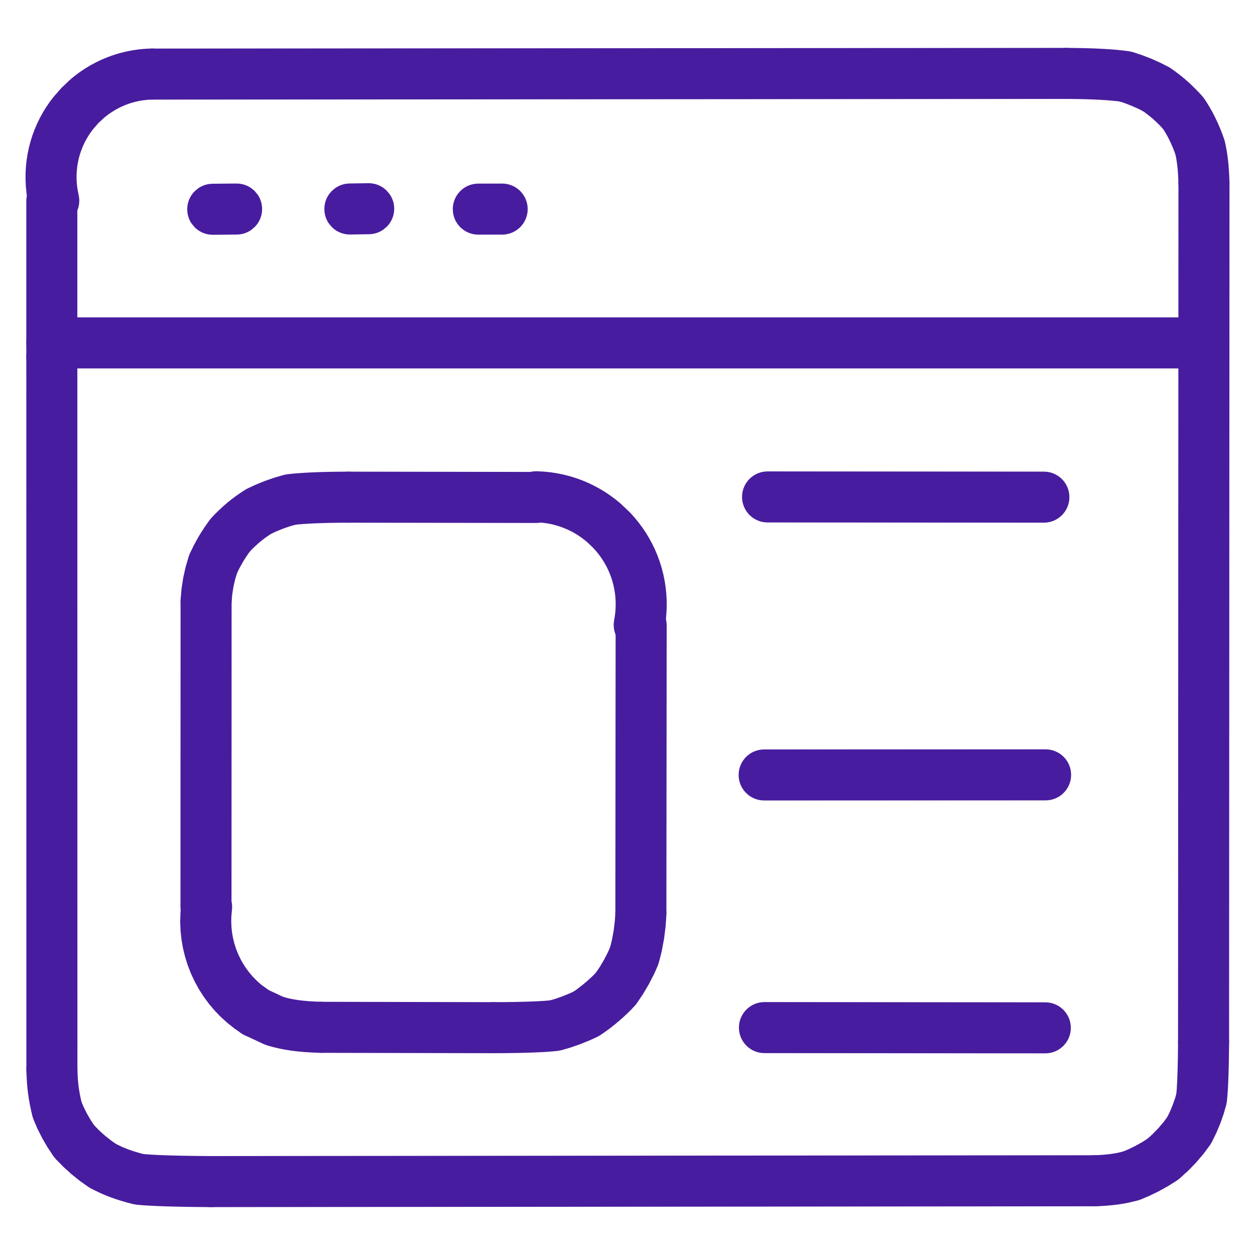
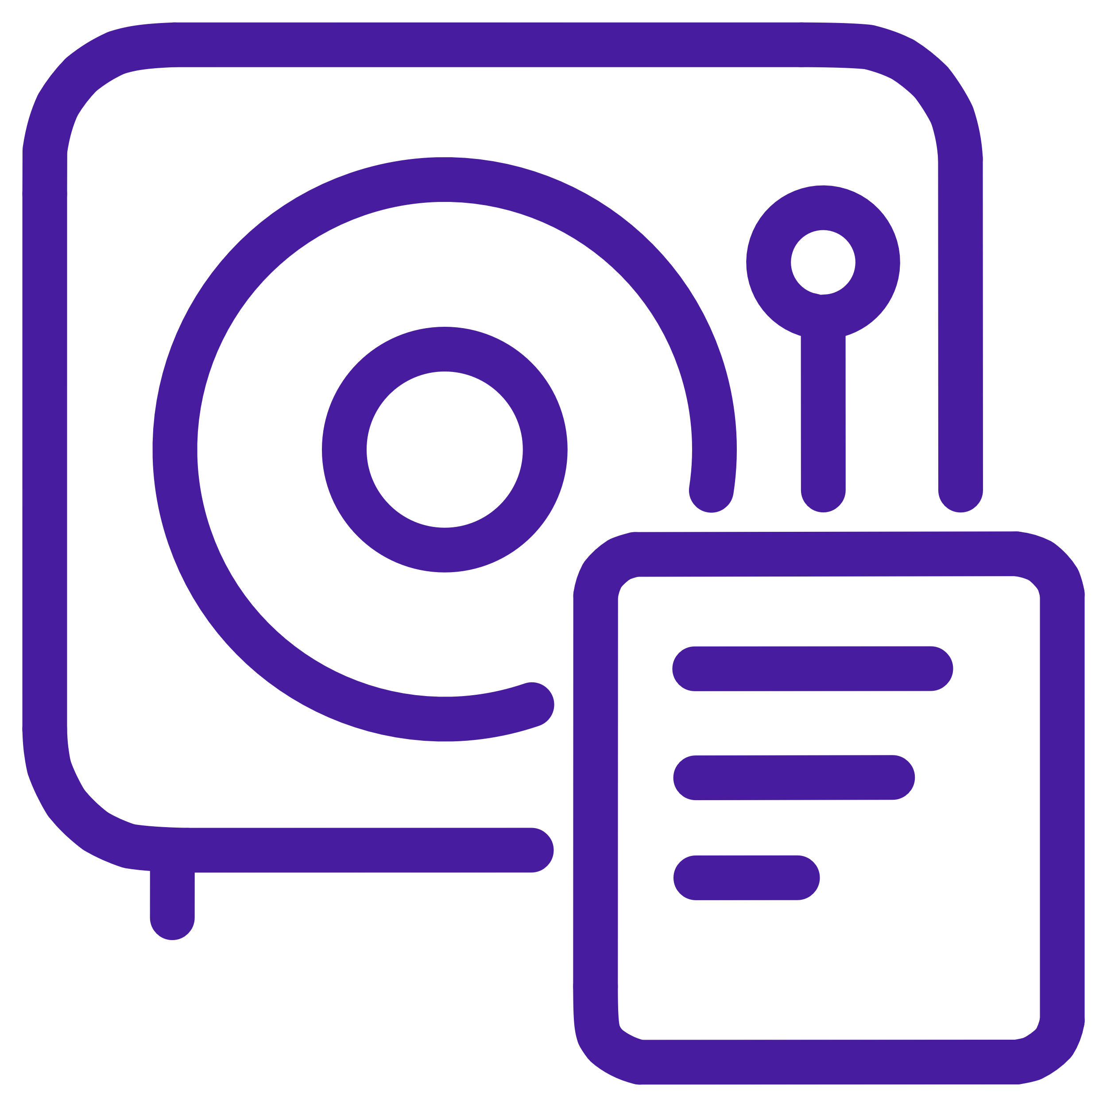
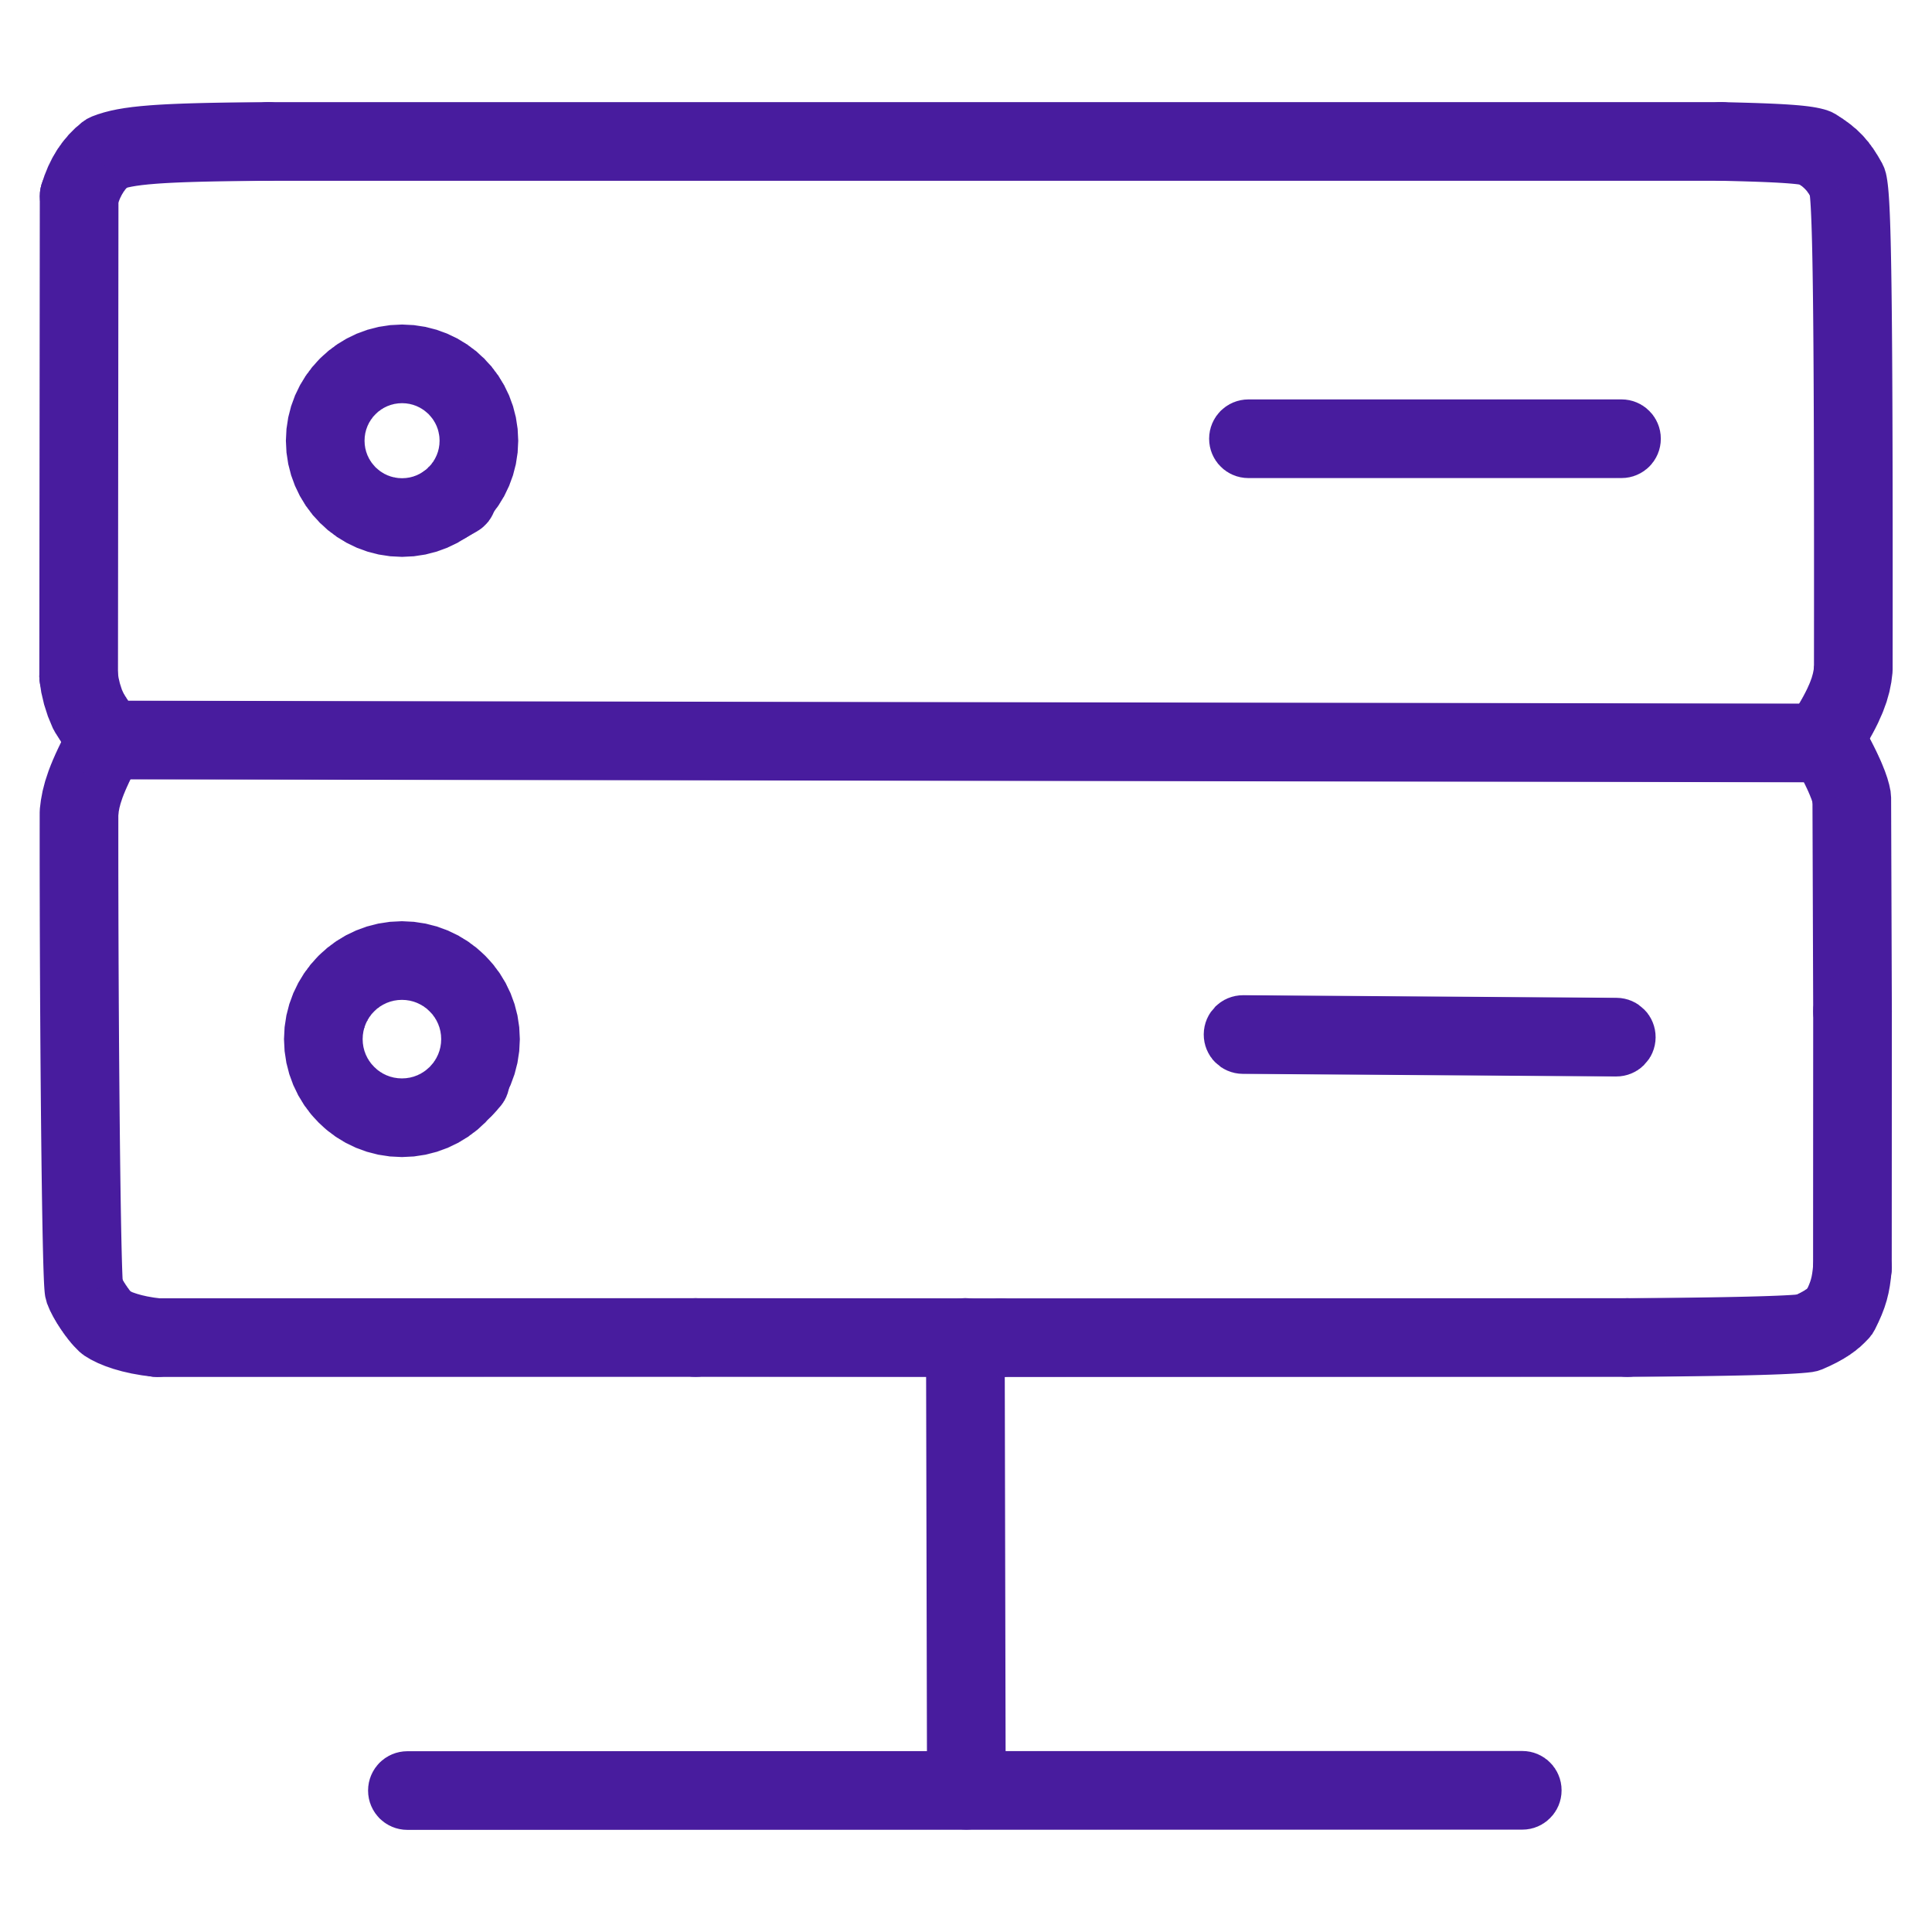

"Five-Minute Magic" & Total Sovereignty
Theory is great, but shipping code is better. We have designed an onboarding process that takes you from zero to a running GraphRAG instance in minutes via Docker.
Gradio UI
Neo4j Database
Ollama API
A built-in interface for immediate interaction and testing of your graph.
The industry standard for graph databases, spun up automatically.
Local inference ensuring your data never leaves your secure environment.
The Promise: You own the model, you own the graph, and you own the data. No dependency on OpenAI or Anthropic.

Slide 10

Roadmap & Call to Action
VeritasGraph is open source and available on GitHub today. We are moving fast to build systems we can actually trust. Join us in moving beyond black-box AI.
Available Now
Core graph construction, hybrid retrieval, and Docker deployment.
Coming Soon
Advanced graph analytics for community detection (Microsoft GraphRAG approach).
Future Vision
Agentic Frameworks to automatically decompose complex queries into sub-tasks.

Slide 11
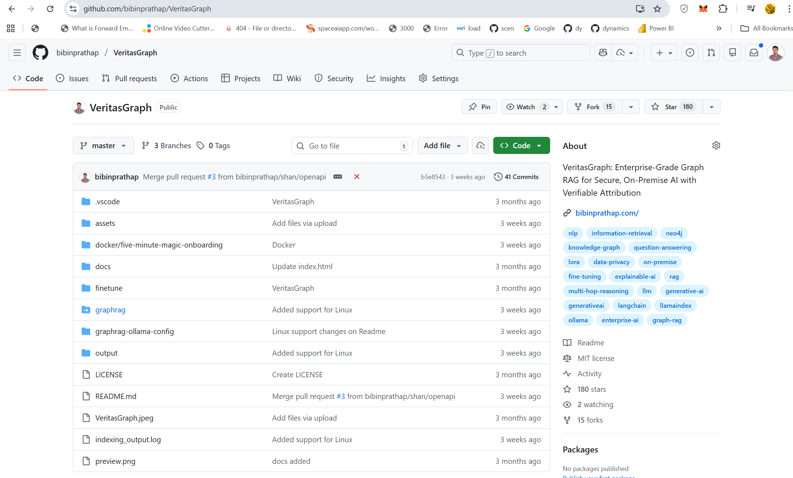
Roadmap & Call to Action
VeritasGraph is open source and available on GitHub today. We are moving fast to build systems we can actually trust. Join us in moving beyond black-box AI.
Available Now
Core graph construction, hybrid retrieval, and Docker deployment.
Coming Soon
Advanced graph analytics for community detection (Microsoft GraphRAG approach).
Future Vision
Agentic Frameworks to automatically decompose complex queries into sub-tasks.

Slide 12

Thank You
Questions?
I'd love to hear from you and discuss how we can work together.
Get in Touch
Learn More
Bibin Prathap
Visit my website for portfolio and additional information
bibinprathap@email.com
bibinprathap.com

